Slide 1
AVIATION ANALYSIS
RISK ASSESSMENT TO DRIVE INVESTMENT ON AIRCRAFTS

Slide 2
PROJECT DESCRIPTION
This project has an objective of trying to:
1. Assist in choosing what make of aircraft to invest in by looking at Fatal accidents
2.What aircraft category to go for by looking at damages sustained by an aircraft
3.what broad phase of flight poses the highest risk towards crashing

Slide 3
Aircraft Investment Risk Assessment Project Overview
This project provides a data-driven framework for **assessing the risk involved in investing in a particular aircraft model**. It supports decision-makers in the aviation finance, leasing, or airline operations sectors by identifying and quantifying risks that influence aircraft investment outcomes.

Slide 4
Business Understanding
When it comes to business nature we are out to avoid losses, the three objectives above will help us determine the make, aircraft category we should invest in since they pose the lowest risk at the same time when a pilot should opt to take flight related risks through the broad phases analysis.

Slide 5
Problem Statement
Investing in aircraft involves significant capital, and poor decisions can lead to financial loss due to market shifts, regulatory changes, or asset underperformance. The goal is to **evaluate the potential risks of different aircraft models** to help investors make informed choices.

Slide 6
Target Users
- Aircraft Leasing Companies
- Aviation Investment Firms
- Airline Fleet Managers
- Financial Analysts in Aerospace

Slide 7
Objectives
- Identify key factors that affect aircraft investment risk
- Analyze what aircraft category poses the lowest and highest risk.
- Identify what aircraft make is likely to kill the highest numbers.
- Provide a recommendation dashboard or report

Slide 8
Key Risk Factors
Aircraft category – what category does the plane in question fall under?
Aircraft make – Affects operating costs, especially with fluctuating fuel prices.
Broad phase of flight – The various stages from ascennding to landing an aircraft experiences.
Total fatal injuries –Deaths resulting.
Aircraft damage – How serious the damage the aircraft sustained.

Slide 9
Methodology Data Collection and Scenario Analysis
The data used was secondary data from kaggle.
- How aircraft category contributes to the damage sustained to the said particular aircraft in the event there is an accident.
- How the total fatal injuries correspond to the make of aircraft used.
-How injury severity varies across the various broad phases of flight.

Slide 10
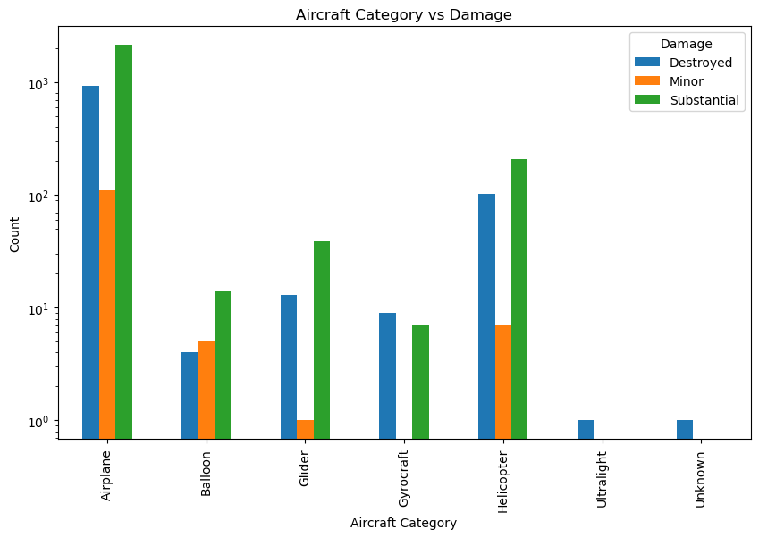

Slide 11
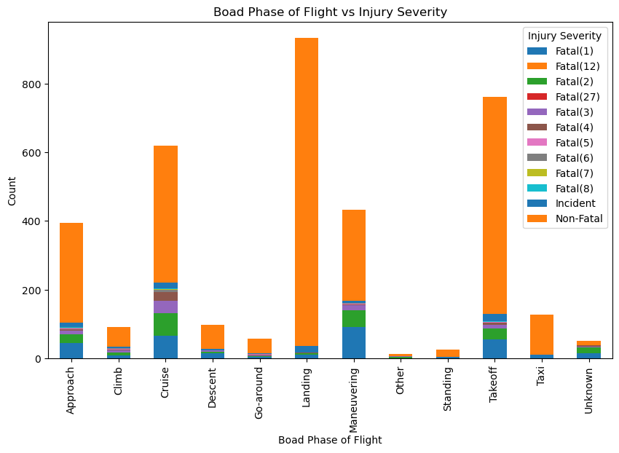

Slide 12
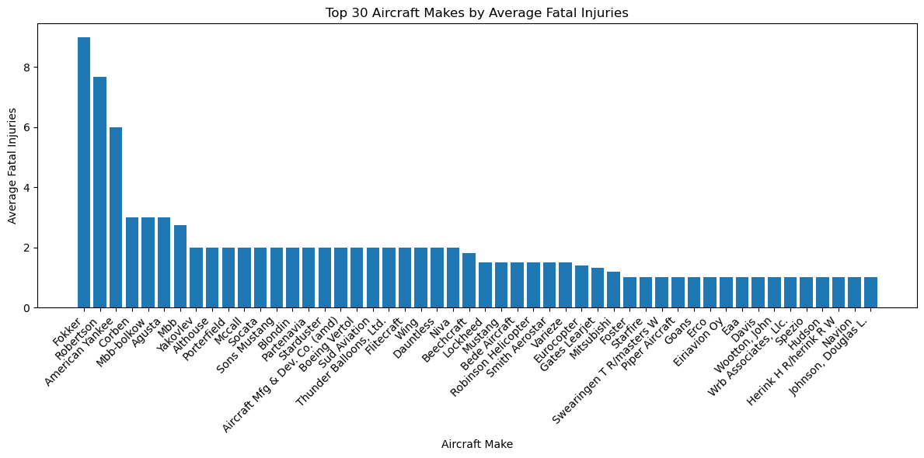

Slide 13
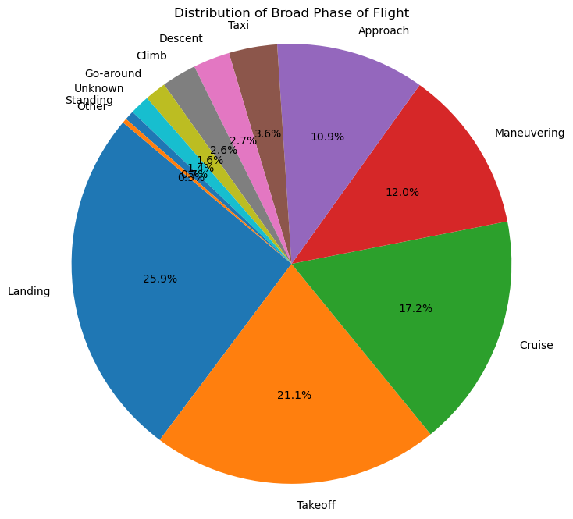

Slide 14
Findings
- Airplanes undergo the highest damage numbers with Gyrocraft having the lowest.
- Fokker (make of aircraft) averages the highest number of fatal injuries compared to other makes.It would be paramount to avoid buying Fokker
- Most injuries are incurred during the landing phase of a flight, This is when the pilot should be 100% attentive to the craft.
- Dashboard with Interactive Filters (Tableau)

Slide 15
Future Improvements
Incorporate ESG (Environmental, Social, Governance) metrics
- Financial aspects are to be observed to make accurate conclusions on investment.
- Return on Investment(ROI) could be a better metric to guide on investment.

Slide 16
THANKS FOR FOLLOWING

